Slide 1

We introduced ourselves as Professional Training Institute known as

Slide 2

OUR OBJECTIVE
Our objective is to be build quality into operations, to ensure zero defect services and thereby achieve excellence in organizational performance.

Slide 3
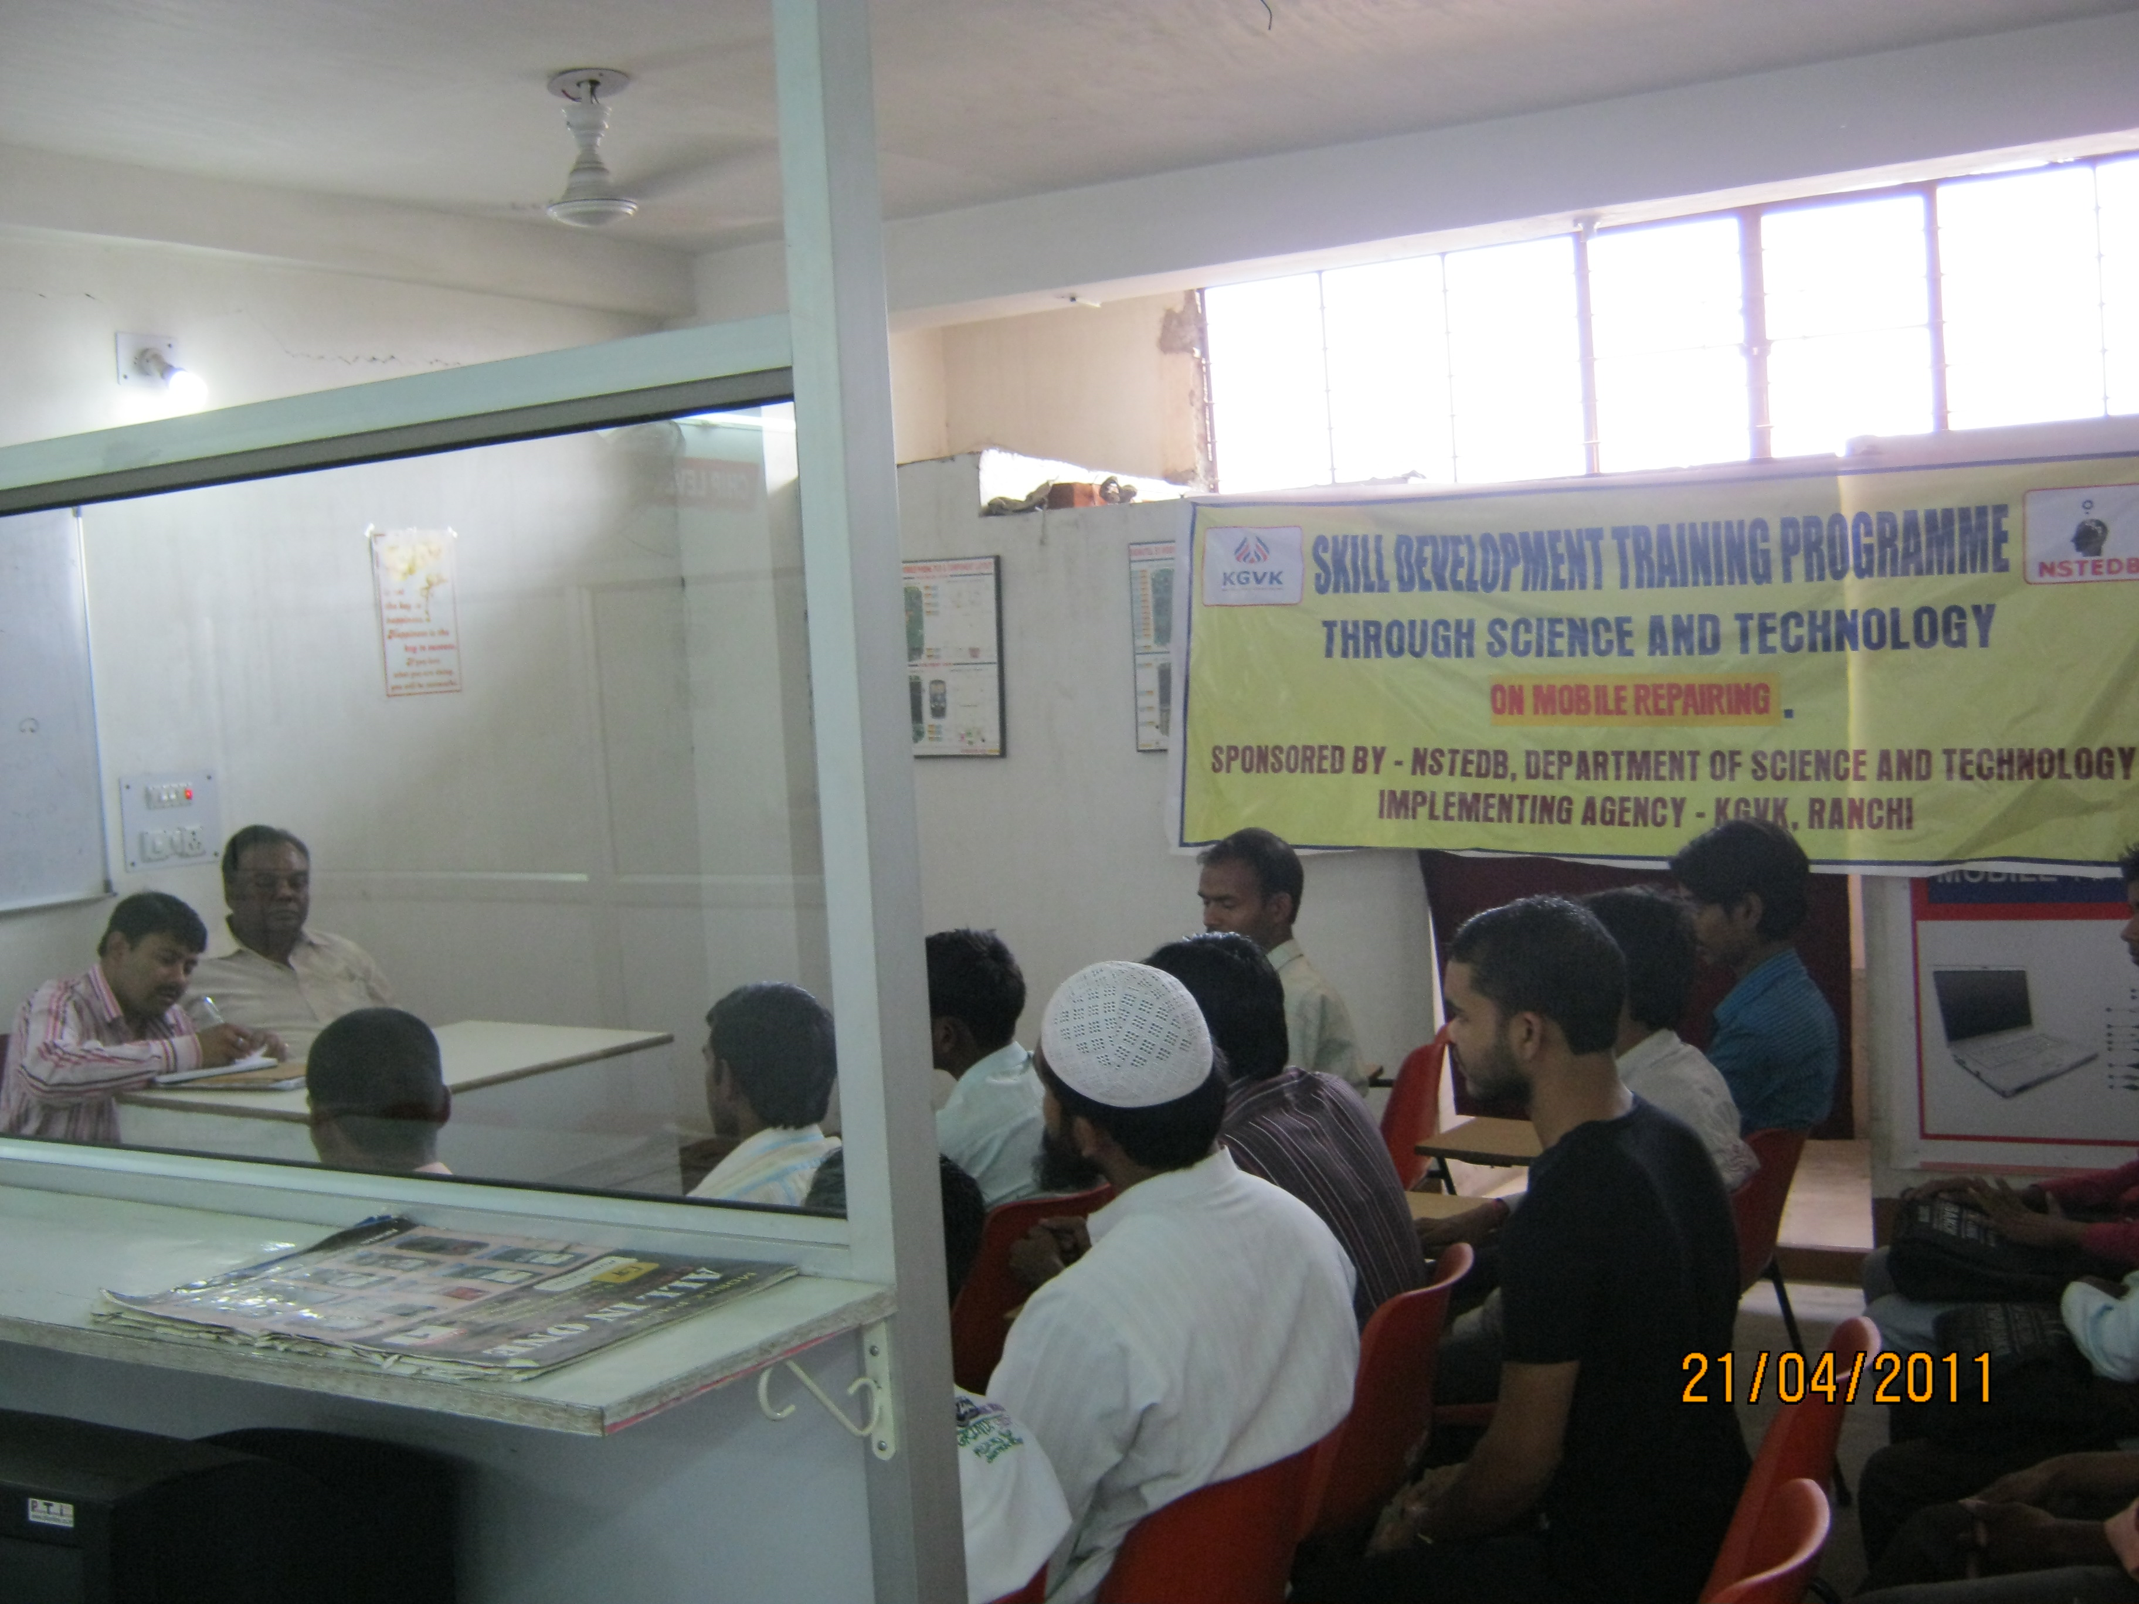
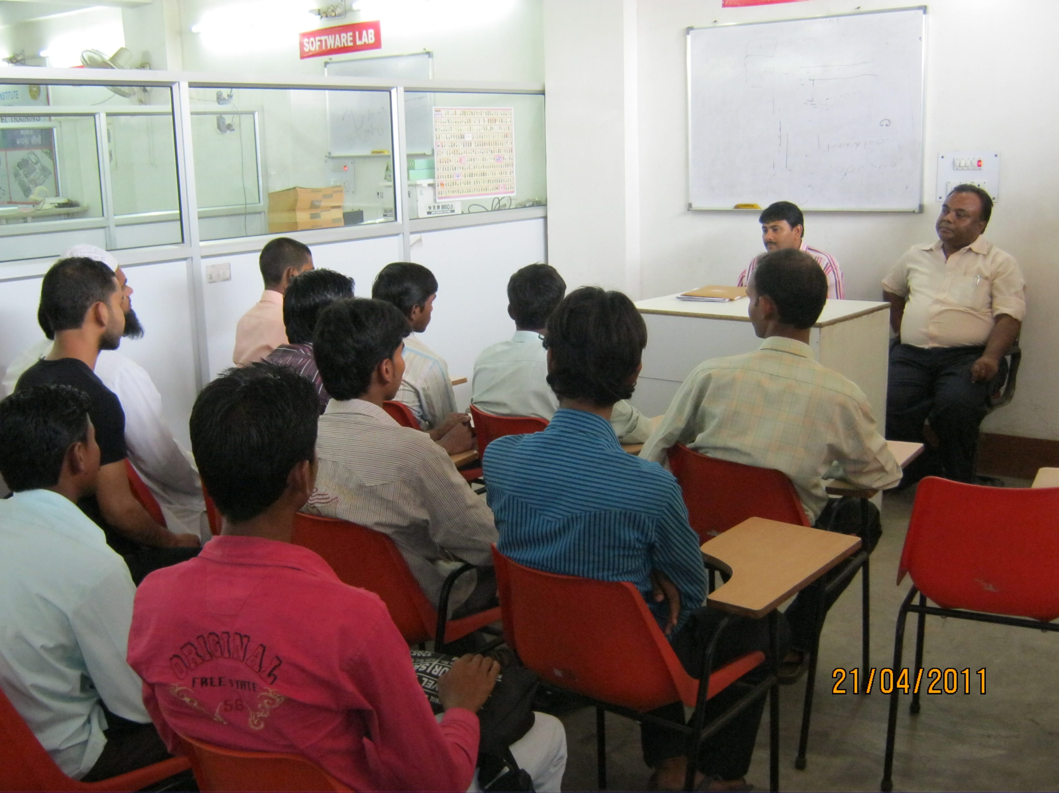



STARTED IN 2003 WITH TRAINING SECTOR
ADITYAPUR PIC
PIC

Slide 4
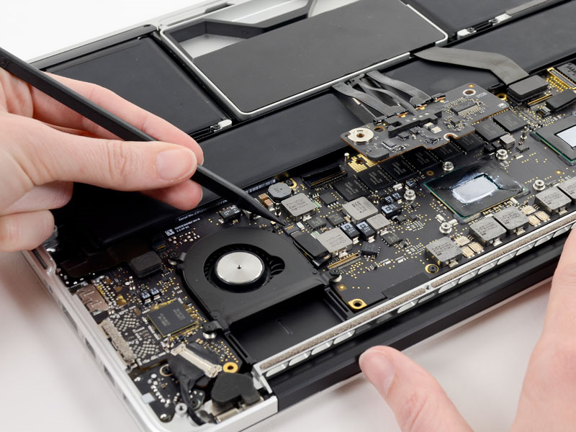
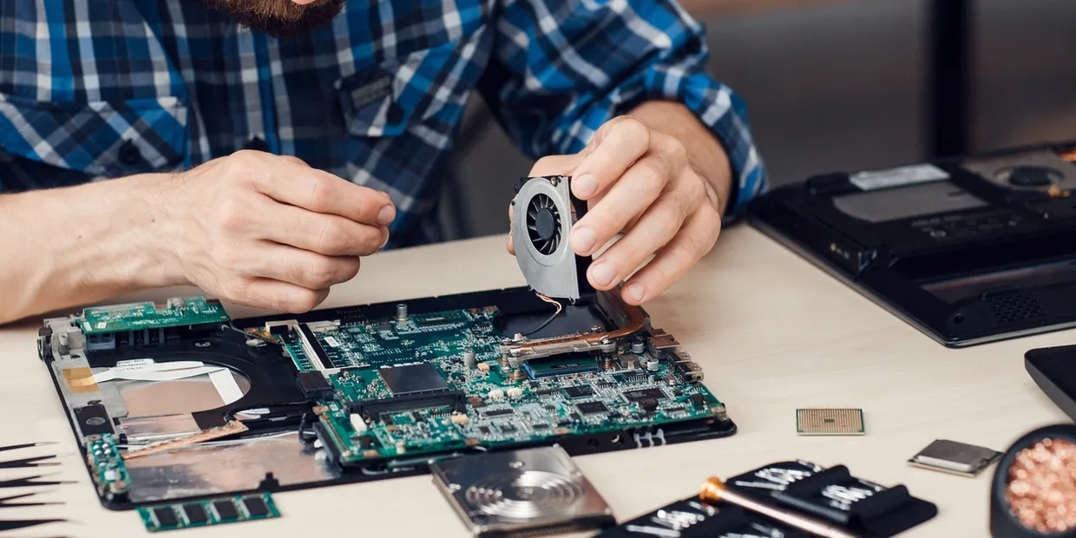
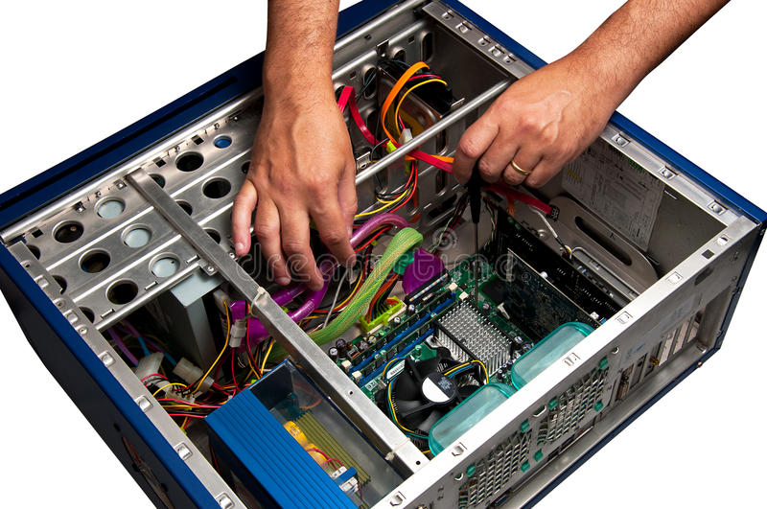
CONVERTED IN SERVICE SECTOR IN 2008
COMPUTER REPAIR
MACBOOK REPAIR
LAPTOP REPAIR

Slide 5
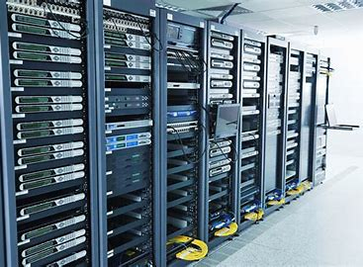
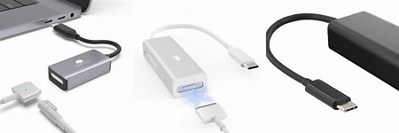

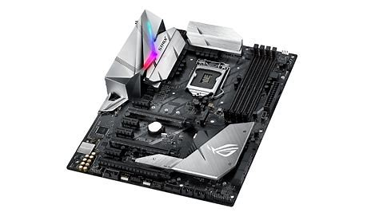
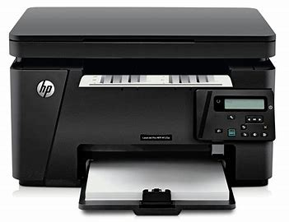

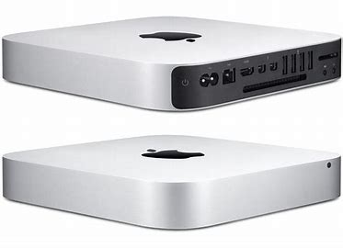
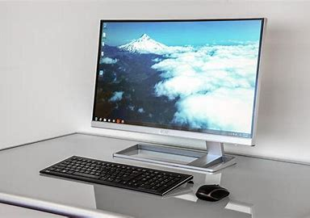
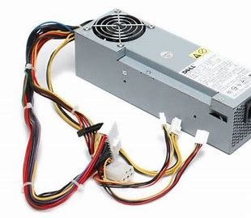

NATURE OF WORK
REPAIRING OF
ADAPTOR
MOTHERBOARD
LAPTOPS
PRINTERS
SERVERS
MONITORS
MACBOOK
I MAC
MINI MAC
SMPS

Slide 6
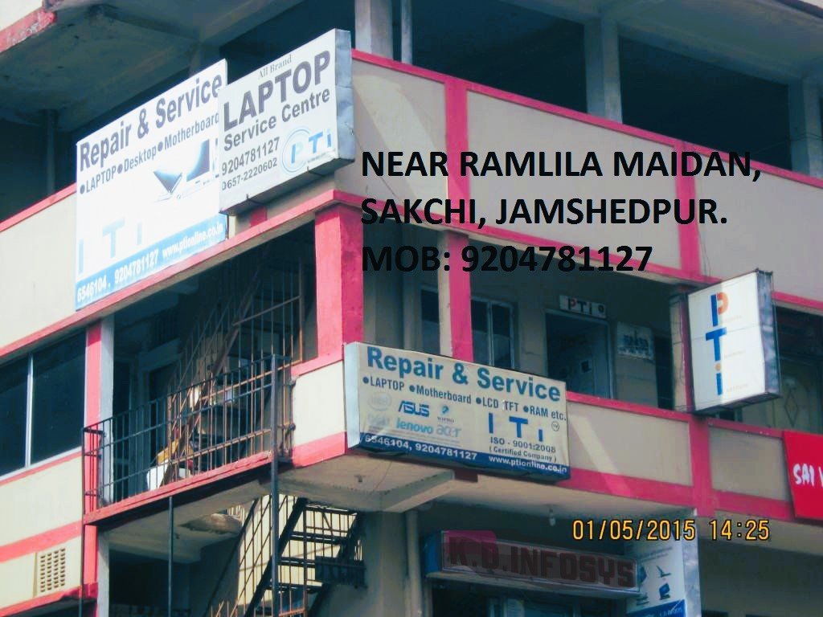
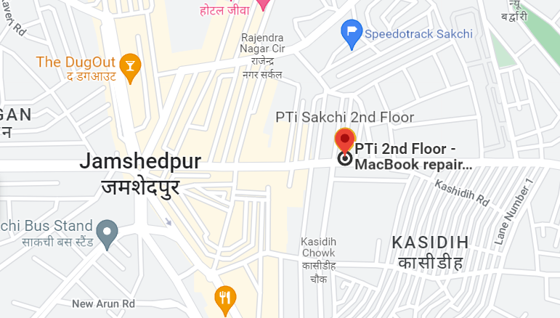
LOCATIONS IN SAKCHI
PTI BUILDING IMAGE

Slide 7
OUR ENGINEERS & MAN POWER
INVENTORY 1
DIAGNOSTIC SECTION 2
SMD SECTION 2
LAPTOP SECTION 2
OQC SECTION 1
DELIVERY BOY 1

Slide 8
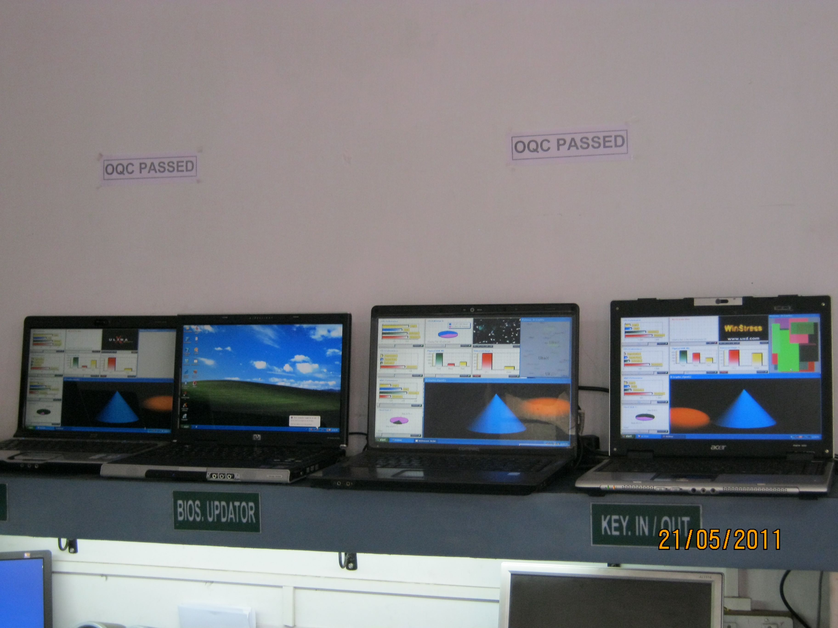
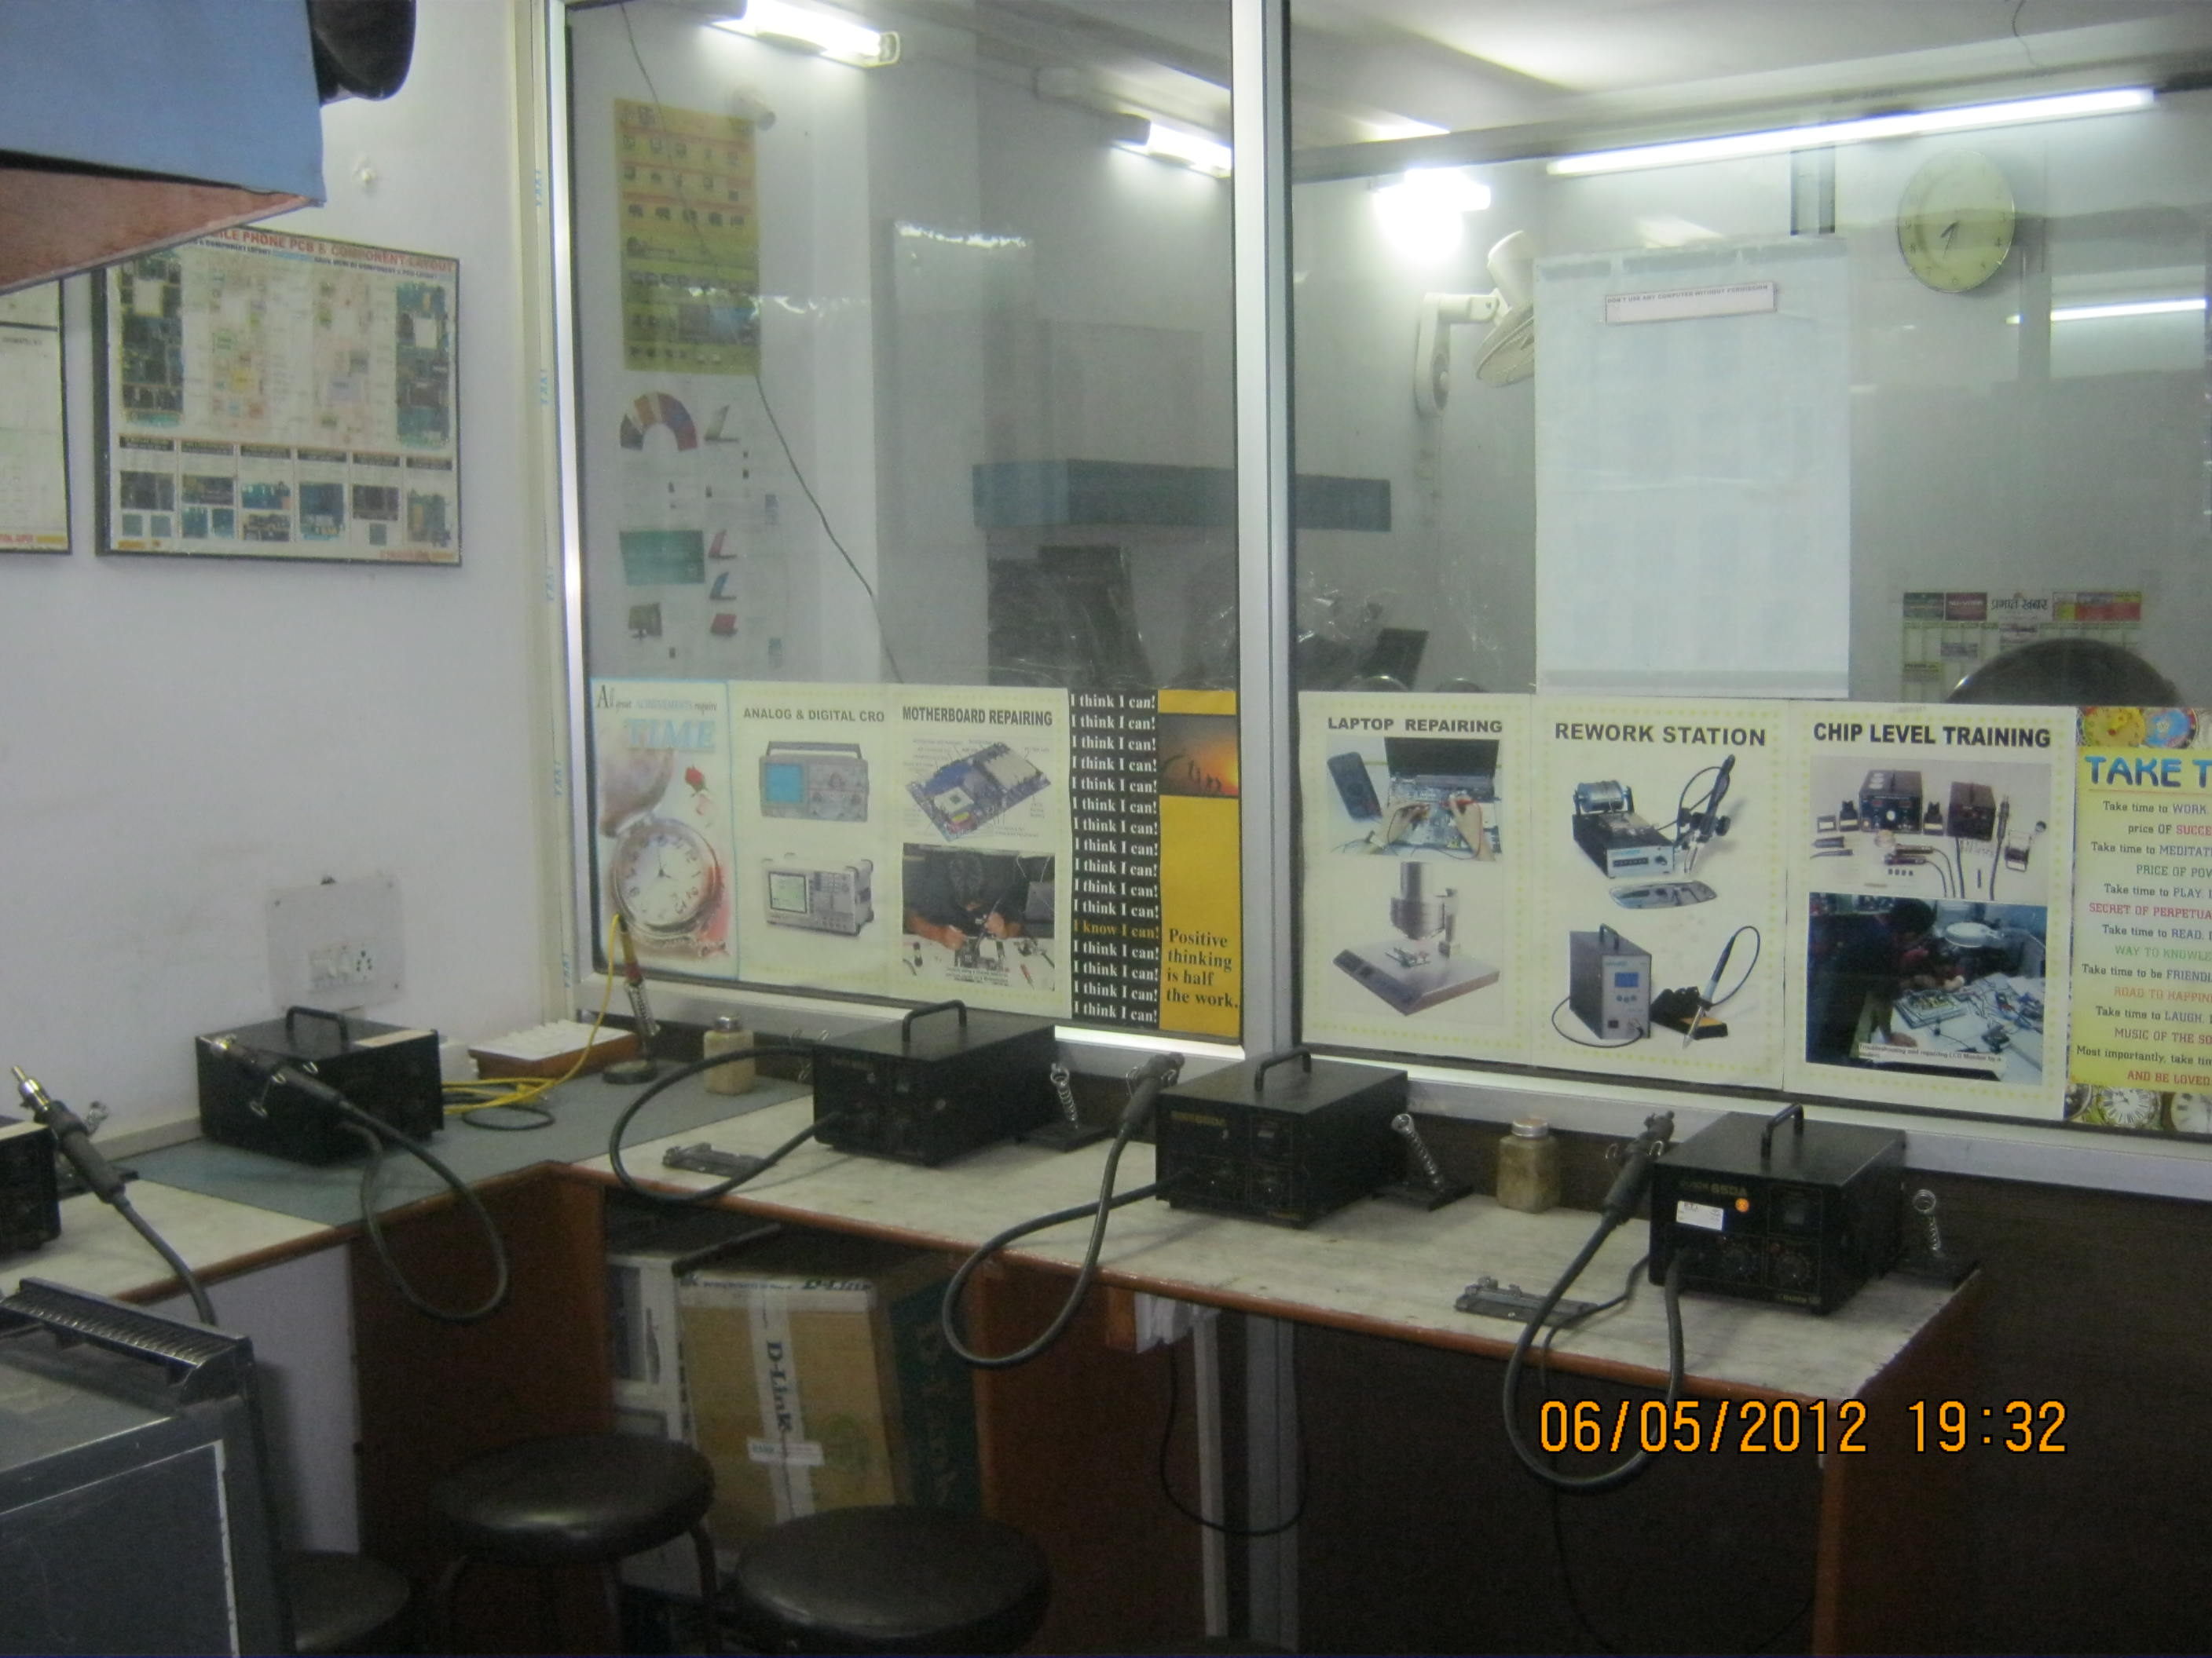
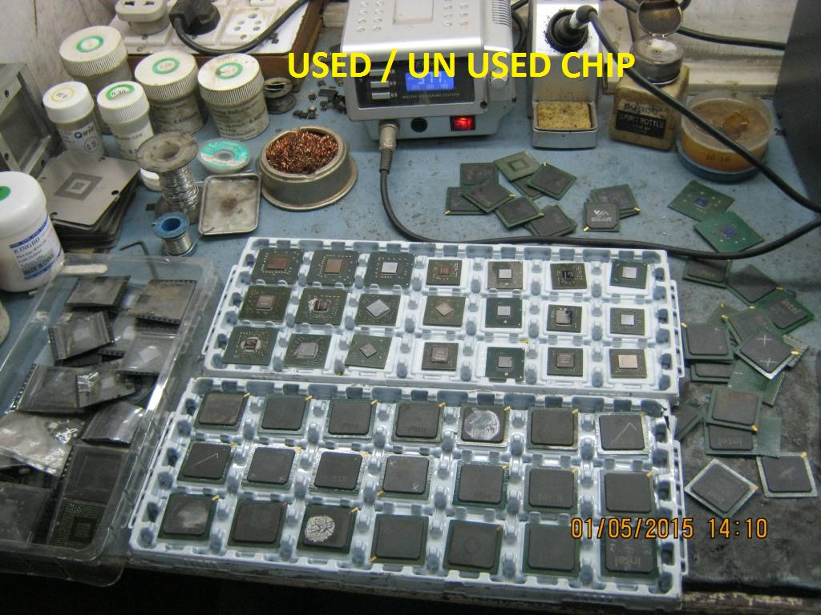
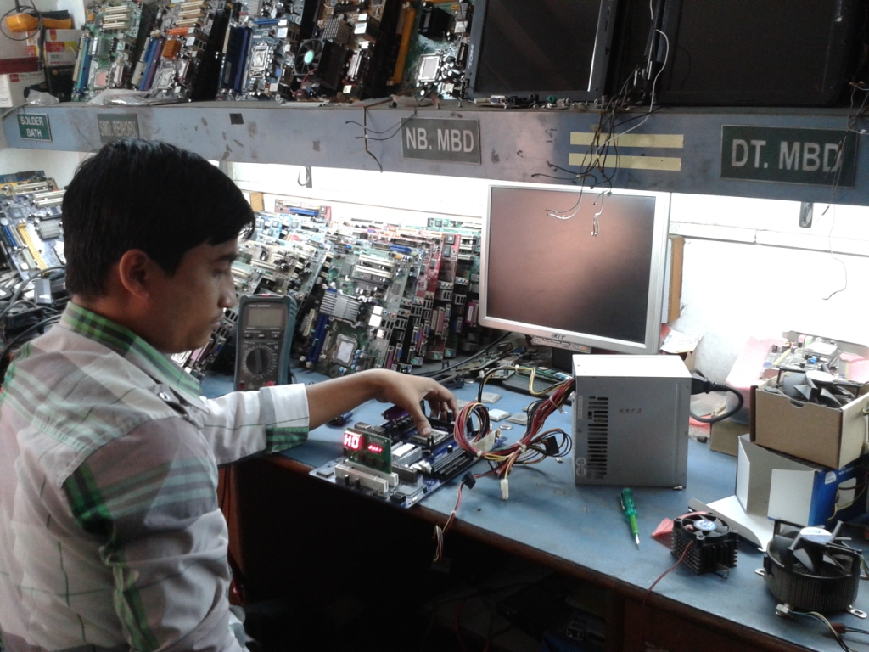
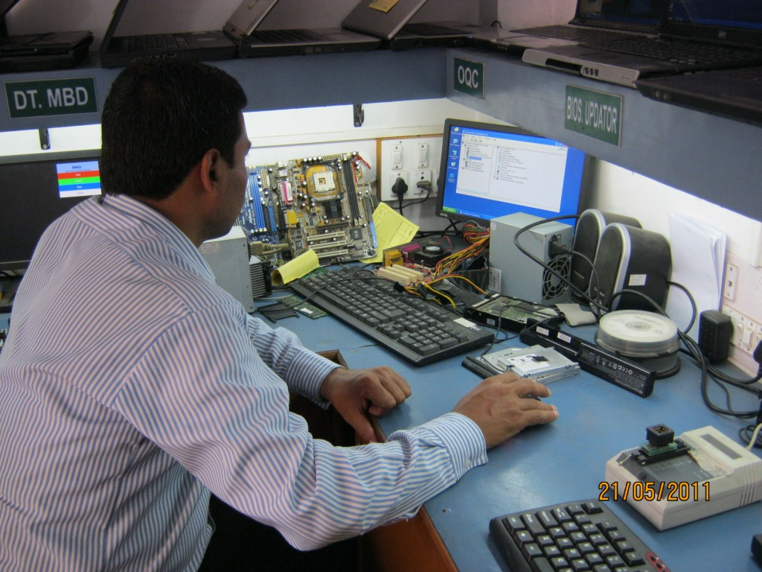
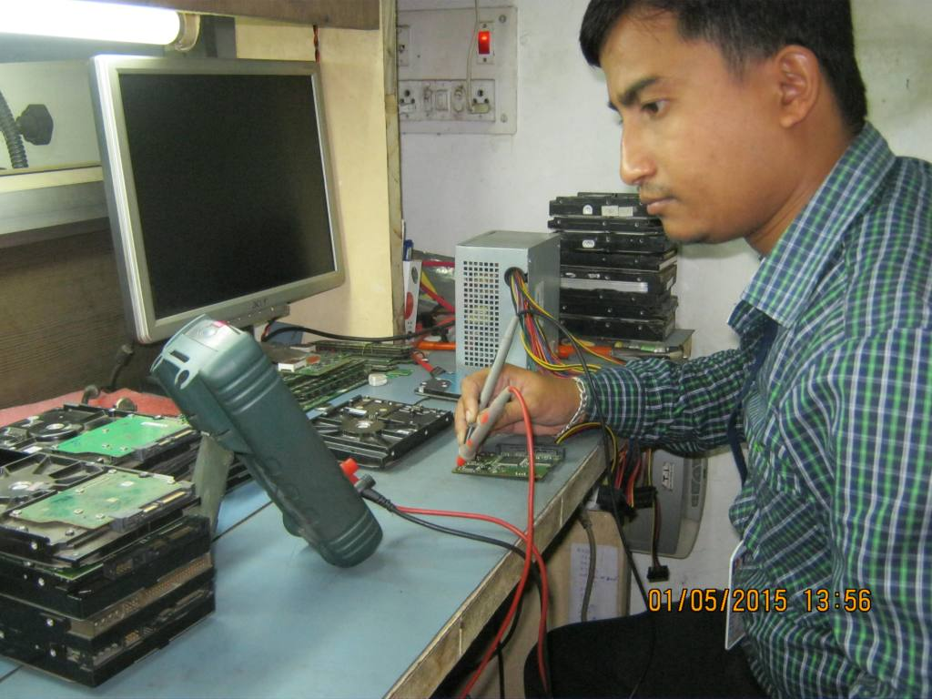
OUR TRC LAB
OQC SECTION
ICS AND COMPONENTS IN STOCKS
WORKING TABLES

Slide 9
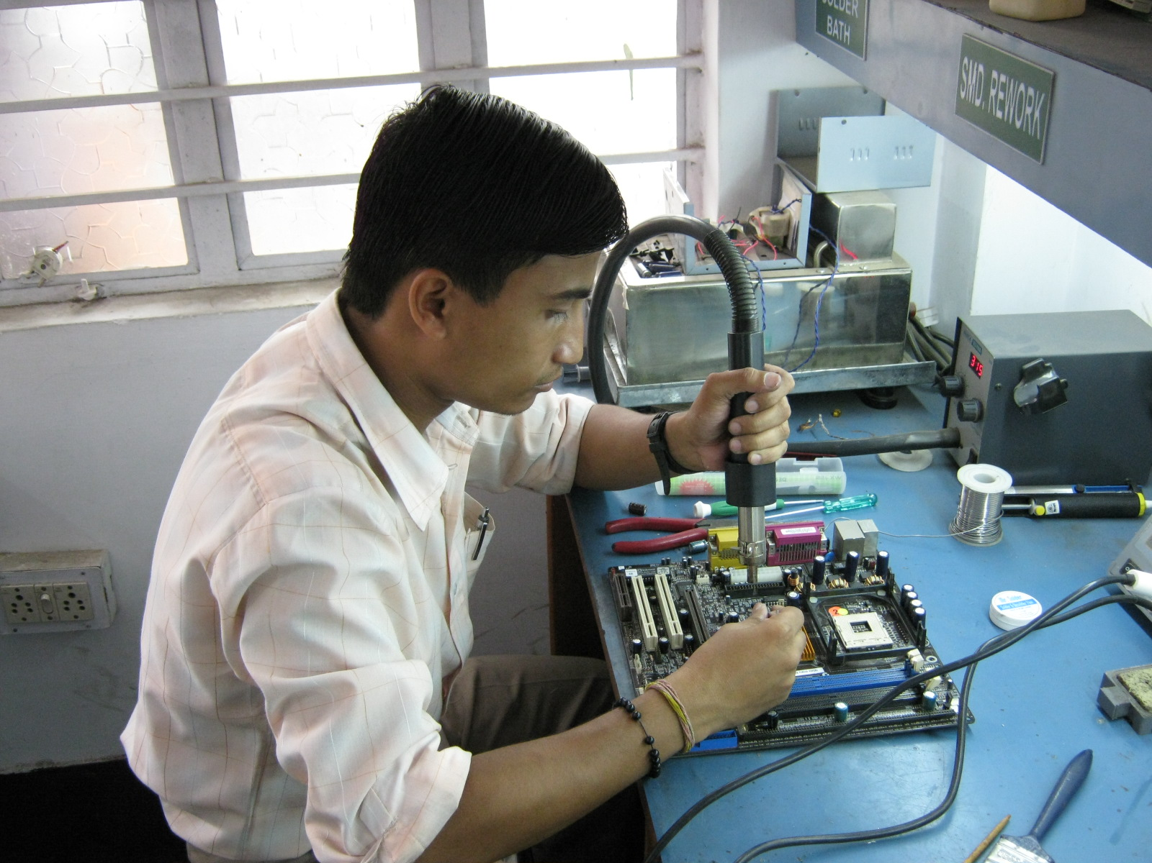
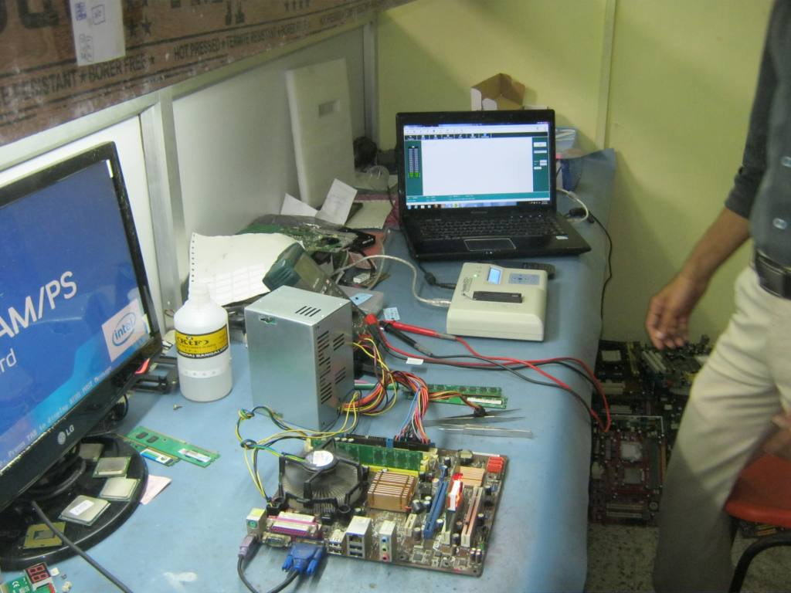
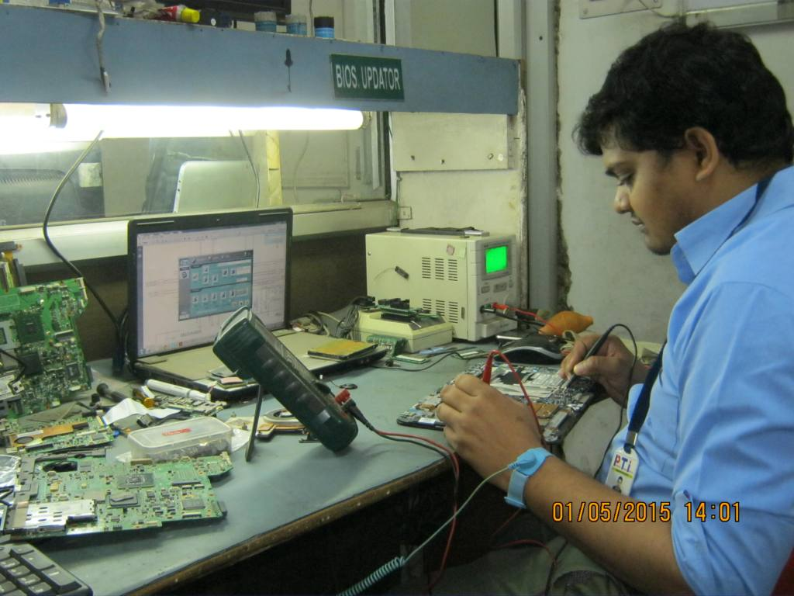
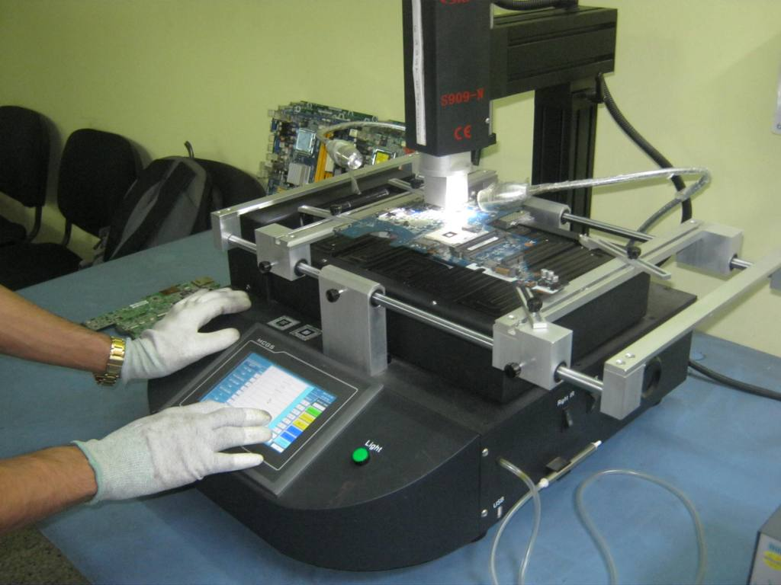
MACHINES AND TOOLS IN PTI

Slide 10



LOW COST IN REPAIR
WARRANTY AFTER REPAIR

Slide 11








OUR MAJOR CLIENTS
XLRI JAMSHEDPUR, WIPRO, XITE GAMARHIA, NELITO, JUPITER SOFTWARE SYSTEM LTD, L&t, ACCEL SERVICES KOLKATA, indo Danish tools room adityapur,

Slide 12

FEEDBACK AND REVIEW OF CUSTOMERS FROM GOOGLE

Slide 13

NOW TIME TO TAKE DECISSION

Slide 14

THANKS FOR GIVING US YOUR PRECIOUS TIME
CONTACT US
SERVICE CENTER ADDRESS :
REG. OFFICE ADDRESS:
H.NO-902, 2ND FLOOR, ST.MILE ROAD, NEAR RAMLILA MAIDAAN, SAKCHI, JAMSHEDPUR. PIN-831001
PHONE : 0657-2220602
MOBILE: 7762804272
H.NO-945, GROUND FLOOR, MOHMADDAN LINE NO-5
SAKCHI, JAMSHEDPUR.-1
MOBILE: 9204781127

